Slide 1
Communicating with Data – Introduction to Interactive Visualization
Dr. Ab Mosca (they/them)
Slides based off slides courtesy of Jordan Crouser (https://jcrouser.github.io/)

Slide 2
Plan for Today
Interaction
Definition
Data and problem spaces
Relationship between interaction and understanding
Interaction with visual interfaces
Basic interaction types
Demo: coordinated multiple views

Slide 3


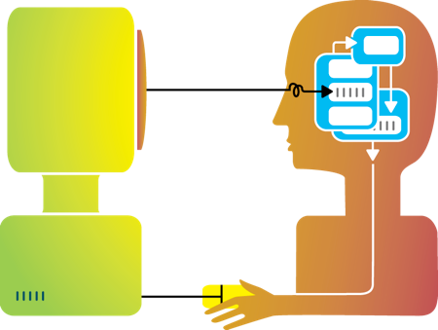
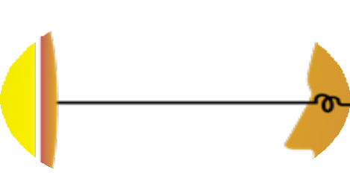
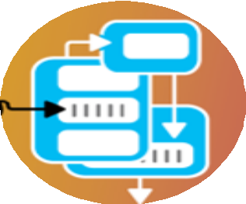




Rewind
Humans and machines have complimentary strengths
Visualization
Perception
and context
Interaction
Computational power
Image credit: Ali Ansari

Slide 4
Interaction (def.)
“Interaction for visualization is the interplay between a person and a data interface involving a data-related intent, at least one action from the person and an interface reaction that is perceived as such.”
Mandatory Components
Interplay
Person
Data Interface
Action
Action-Reaction
Reaction Perceived as Such
Data-Related Intent
What is Interaction for Data Visualization? Evanthia Dimara, Charles Perin. 2020
Notes:
Interplay – “dialogue”
Person -
Data Interface– the vis
Action – Any action, physical or mental, regardless of modality that causes the reaction of the data interface
Action-Reaction– cause effect between entities
Reaction Perceived as Such – person must perceive the reaction in the data interface
Data-Related Intent – intent is tied to a data source and is formed iteratively throughout the interaction cycle

Slide 5
High level: between human and problem space
a cognitive act enabled by the tool
does not need to take place exclusively within them
might be distributed across multiple tools
Low level: between human and interface
the set of operations available
the relationship between the human and the visualization
Interaction

Slide 6
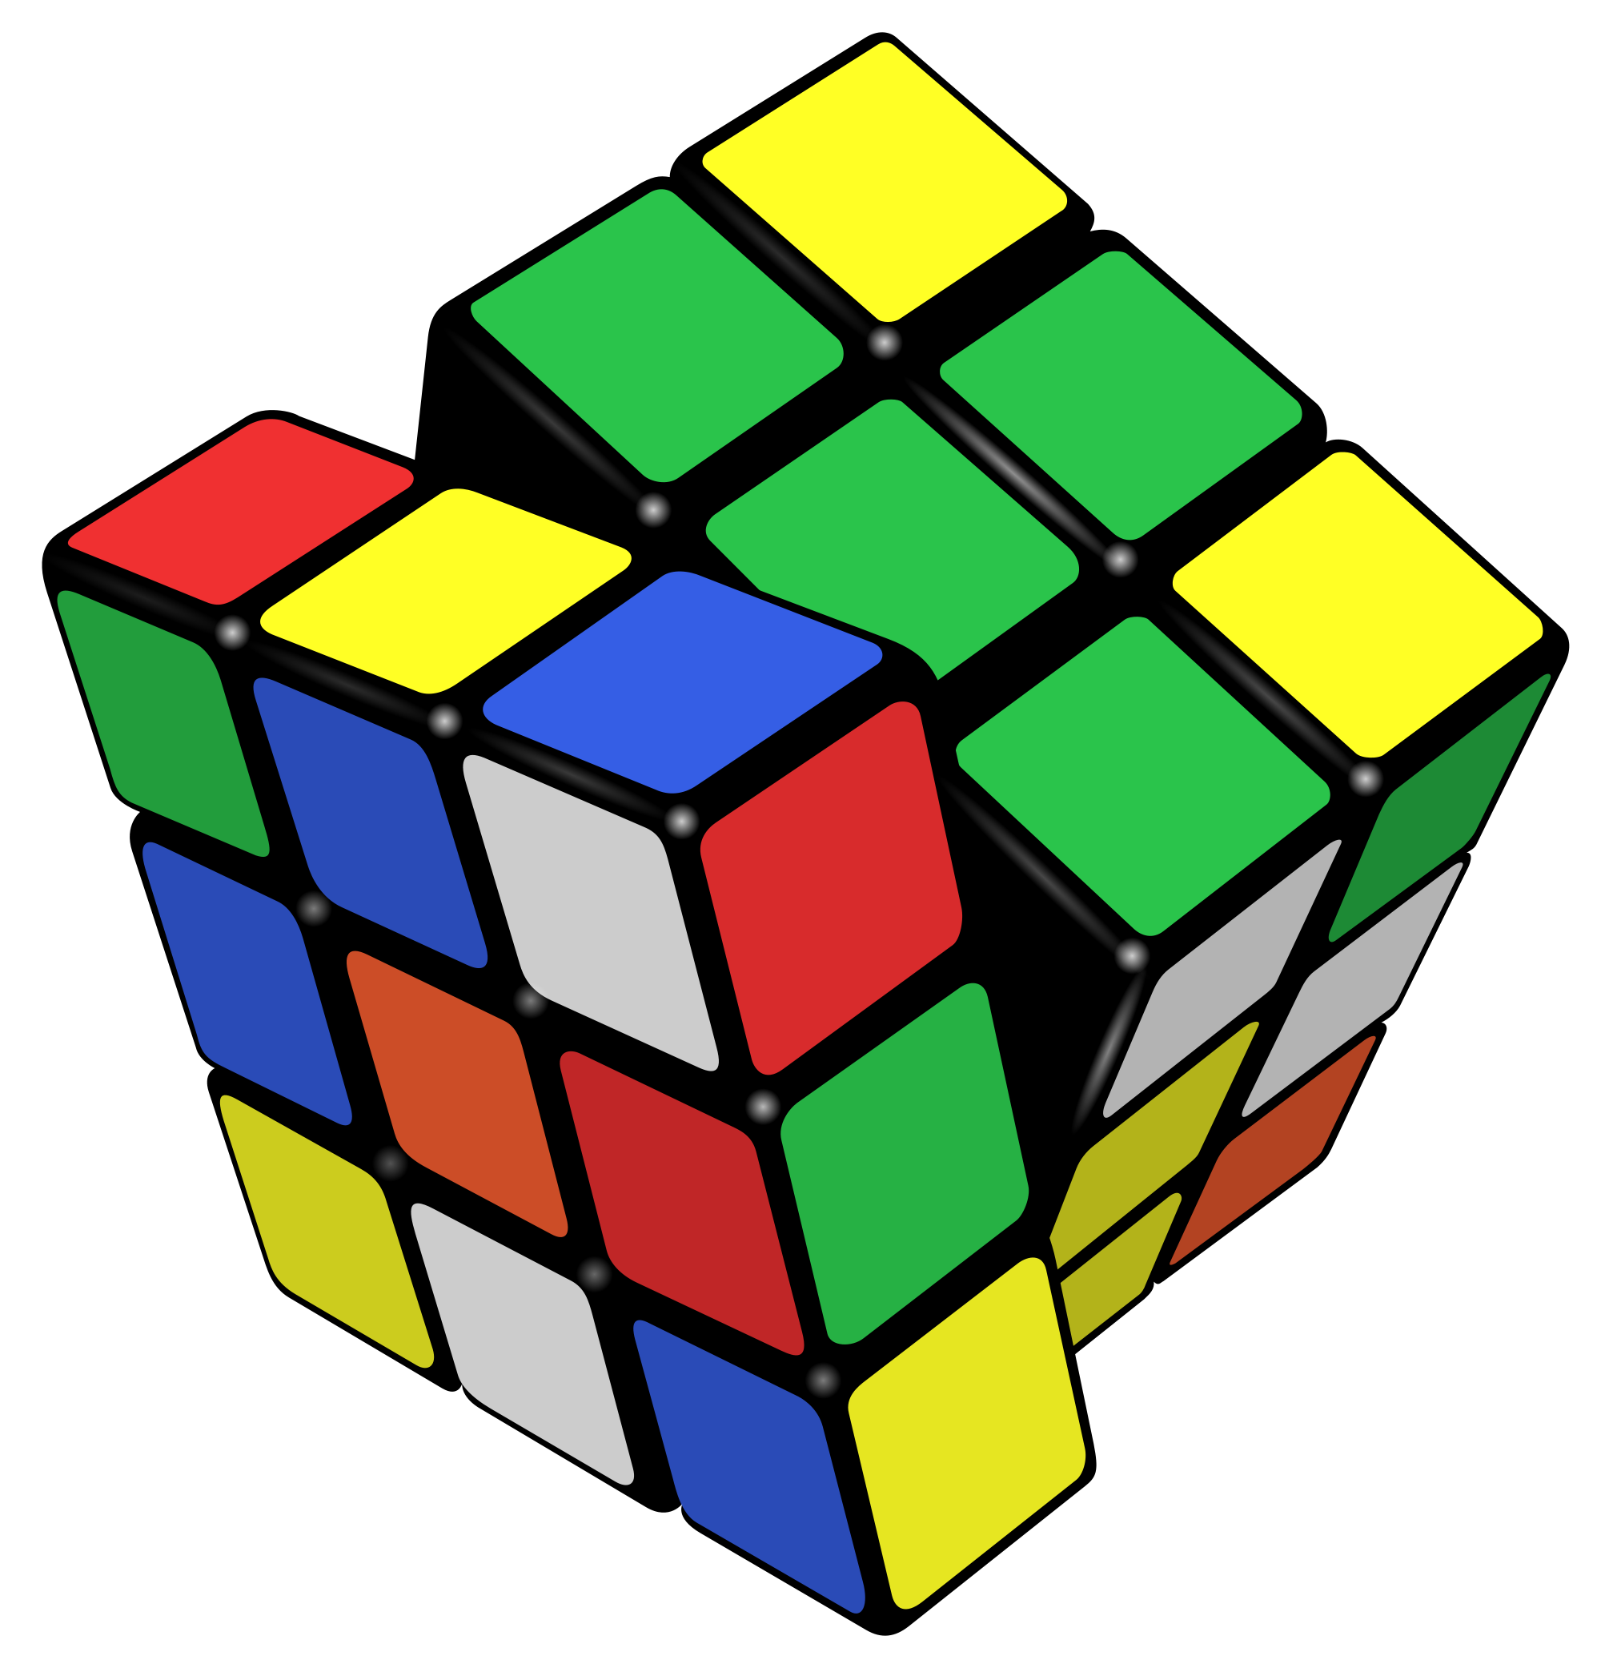
Example: Rubik’s Cube
What high-level interactions are there?
What low-level interactions could there be?

Slide 7



Example: Vitals
What high-level interactions are there?
What low-level interactions could there be?

Slide 8

Example: Lumos
https://lumos-webapp-4aeadb3bf30d.herokuapp.com/
What were your high-level interactions?
What were your low-level interactions?
Notes:
Explore & find something interesting

Slide 9
Part I: High Level
Interaction with
Data / Problem Space

Slide 10
High-level interactions with a visualization correspond to analysis tasks
We can think about why users perform interactions at different levels of specificity
Brehmer and Munzner (2013)
M. Brehmer and T. Munzner, "A Multi-Level Typology of Abstract Visualization Tasks," in IEEE Transactions on Visualization and Computer Graphics, vol. 19, no. 12, pp. 2376-2385, Dec. 2013, doi: 10.1109/TVCG.2013.124.

Slide 11
Learn
Read a data story; be guided through a series of cognitive operations
Discover
Generation and verification of hypotheses, associated with models of scientific inquiry
Enjoy
Casual encounters with visualization
User is not driven by a need to verify or generate a hypothesis; novelty stimulates curiosity and exploration
Generate
Create new artifacts such as transformed or derived data, annotation, recorded interactions, screenshots
High-level Interaction: broadly, why
Notes:
Presentation using visualization may take place within the context of decision making, planning, forecasting, and instructional processes
Discover - Scientific investigation may be motivated by existing theories, models, and hypotheses, or by the serendipitous observation of unexpected phenomena
Enjoy - Casual encounters with visualization can be fleeting, such as in the earlier example of encountering a static choropleth electoral map while reading a blog post. Conversely, these encounters might be immersive and time-consuming experiences, such as in museum settings

Slide 12
A user may interact with a visualization to:
Identify
Find a characteristic(s) about a target
Ex. User of a choropleth map identifies the margin of victory for the winning election candidate in CA
Compare
Refers to multiple subsets of targets
Ex. User of a choropleth map identifies election results for CA and compares them to results for MA
Summarize
Refers to a whole set of targets
Ex. User of a choropleth map summarizes election results across all states
High-level Interaction: specifically, why

Slide 13
Part II: Low Level
Interaction with
a Visual Interface

Slide 14
Yi, Kang, Stasko and Jacko (2007)
Select
Explore
Reconfigure
Encode
Abstract/Elaborate
Filter
Connect
Yi, J. S., ah Kang, Y., Stasko, J. T., & Jacko, J. A. (2007). Toward a deeper understanding of the role of interaction in information visualization. Visualization and Computer Graphics, IEEE Transactions on, 13(6), 1224-1231.

Slide 15
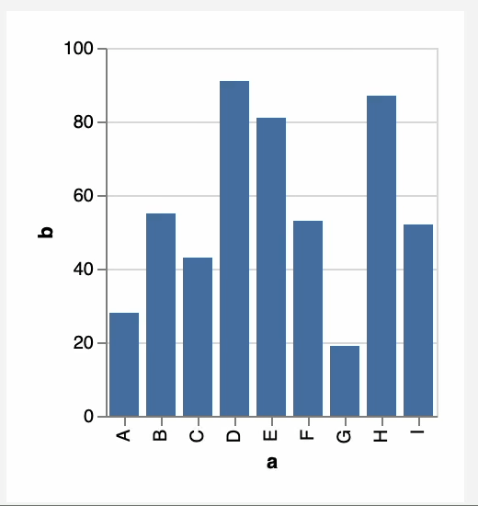
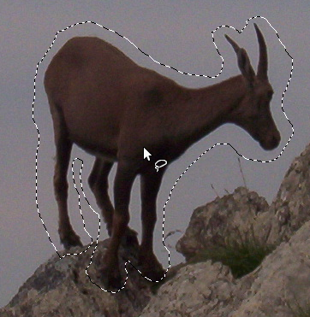
1. Select
Mark something as interesting: direct

Slide 16
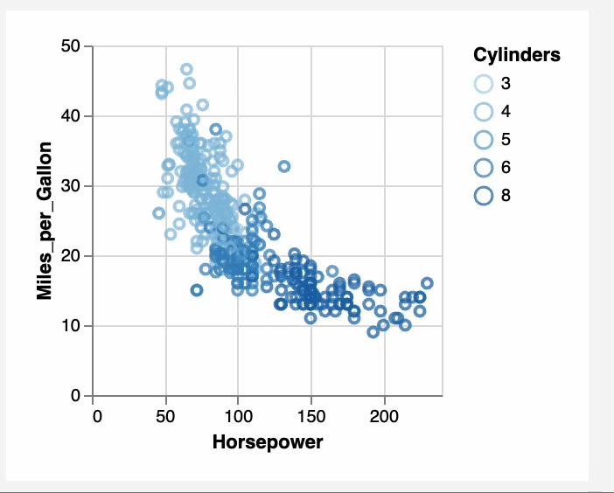
Mark something as interesting: indirect
1. Select
Notes:
Brushing

Slide 17
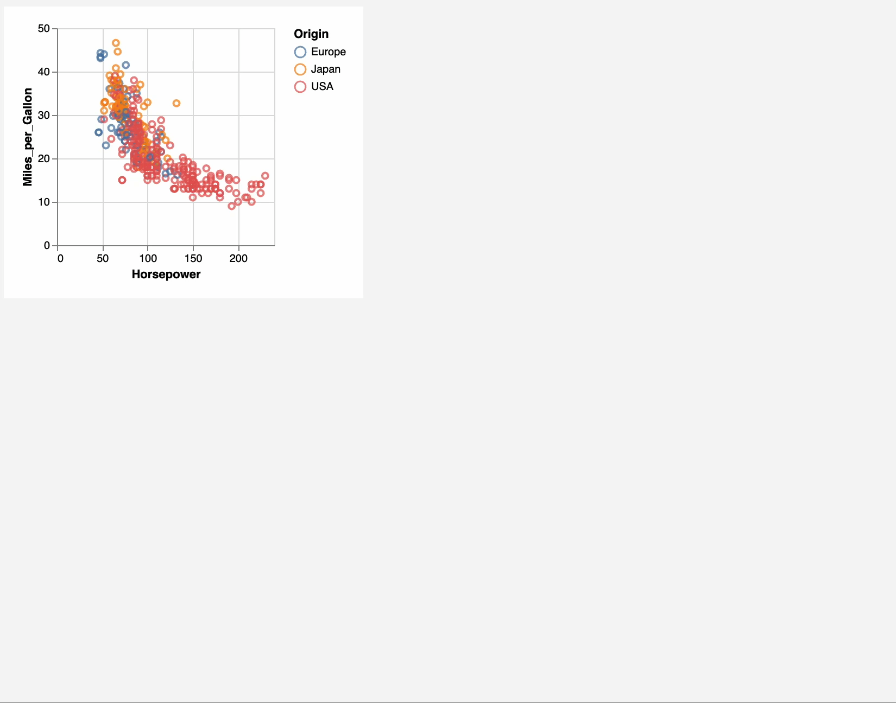
Show me something else
Scroll bars
Panning
Direct-Walk (e.g. hyperlink traversal)
2. Explore

Slide 18
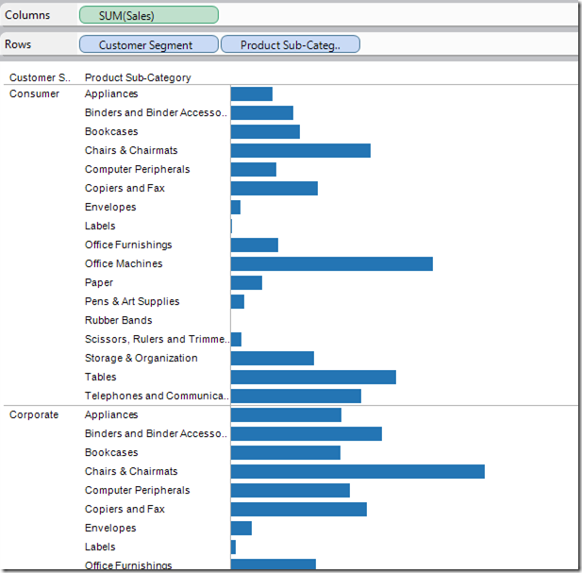
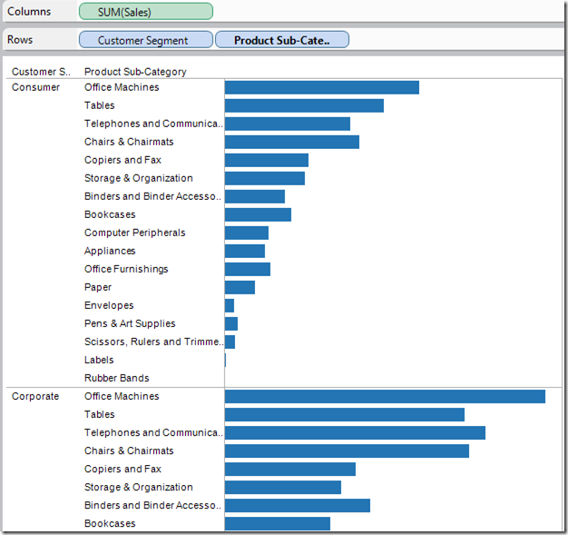
3. Reconfigure
Show me a different arrangement: sorting

Slide 19
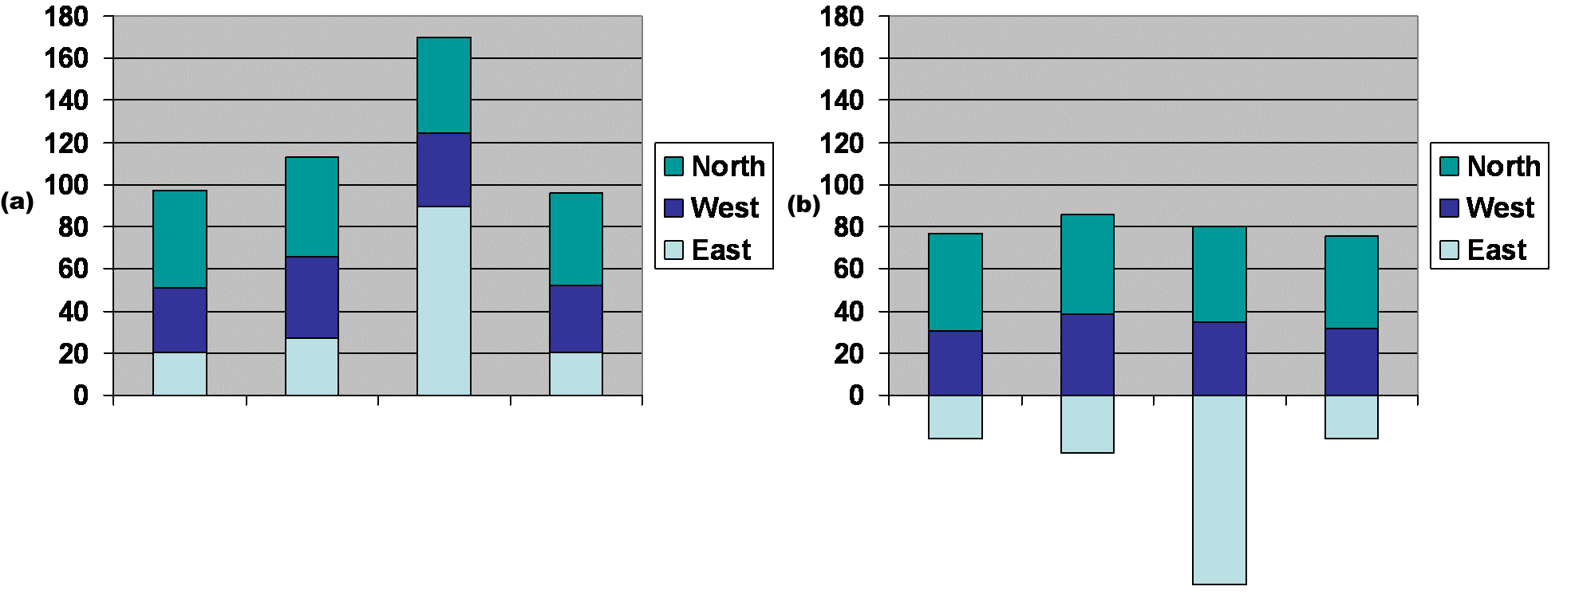
3. Reconfigure
Show me a different arrangement: baseline adjustment

Slide 20
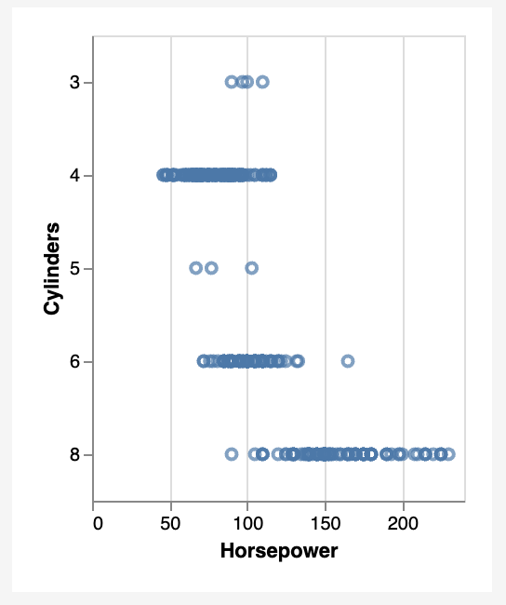
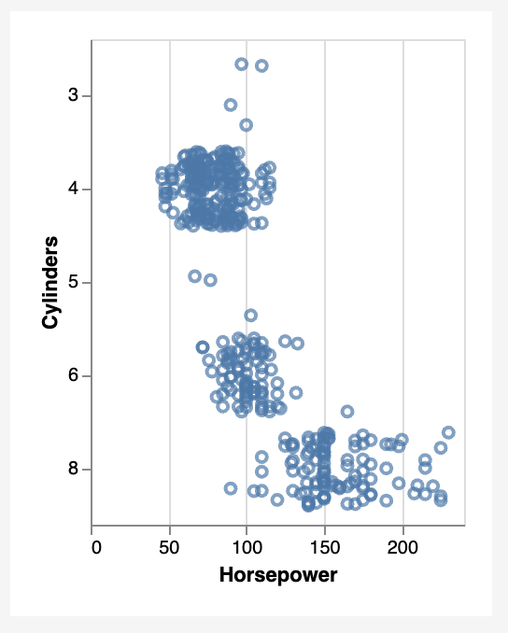
Show me a different arrangement: reduce occlusion (jitter)
3. Reconfigure

Slide 21
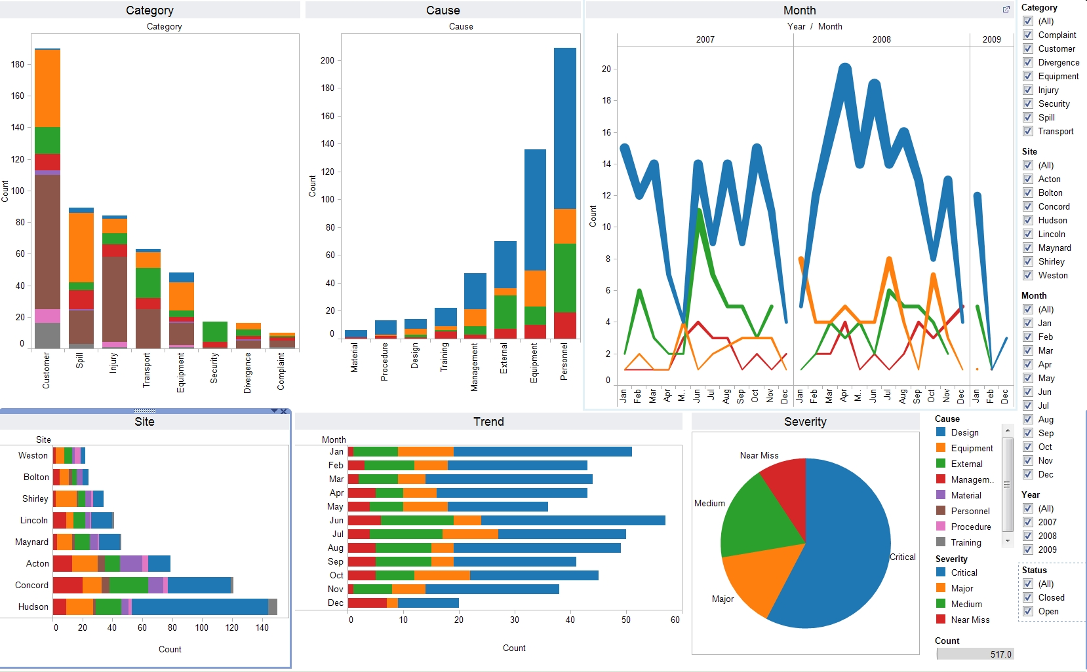
4. Encode
Show me a different representation: visualization type, color, size, orientation, etc.

Slide 22
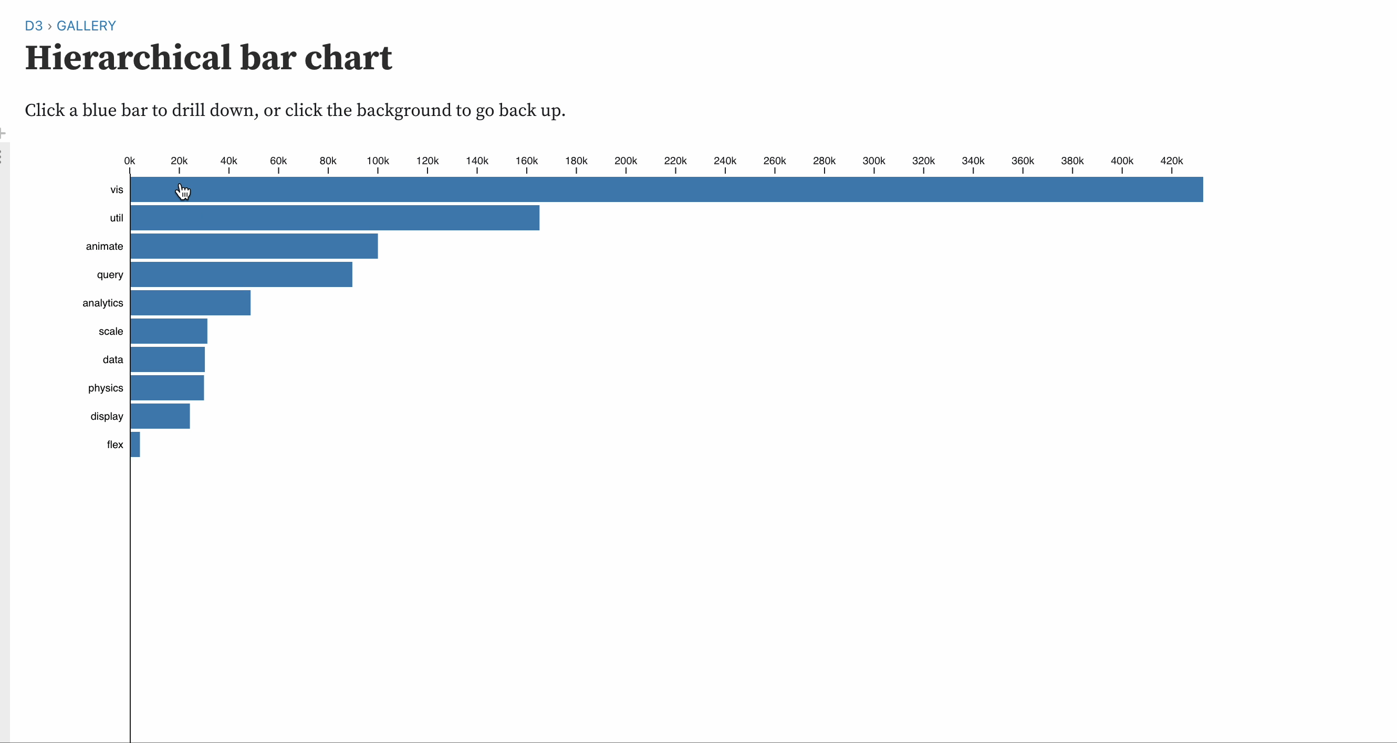
5. Abstract / Elaborate
Show me more or less detail: drill up/down

Slide 23
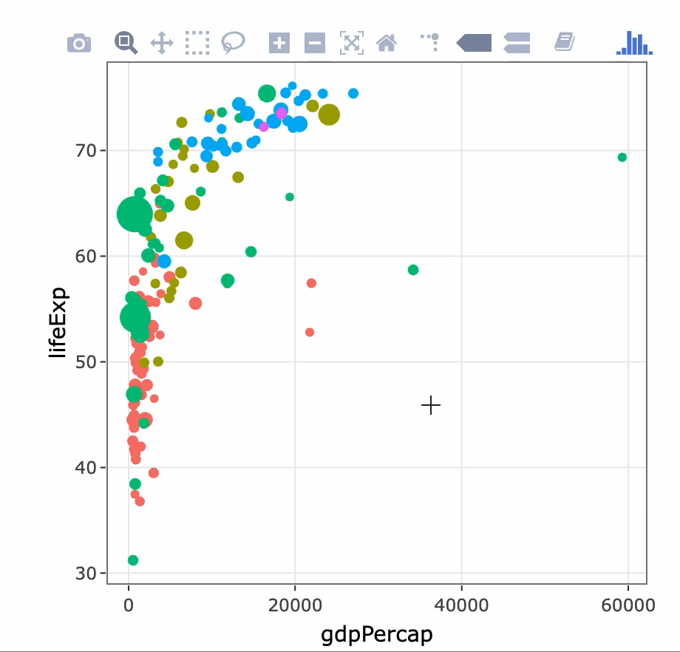
5. Abstract / Elaborate
Show me more or less detail: zooming

Slide 24
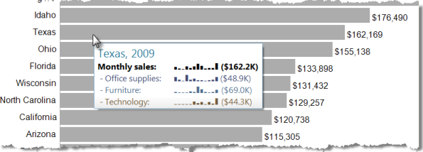
5. Abstract / Elaborate
Show me more or less detail: tooltips

Slide 25
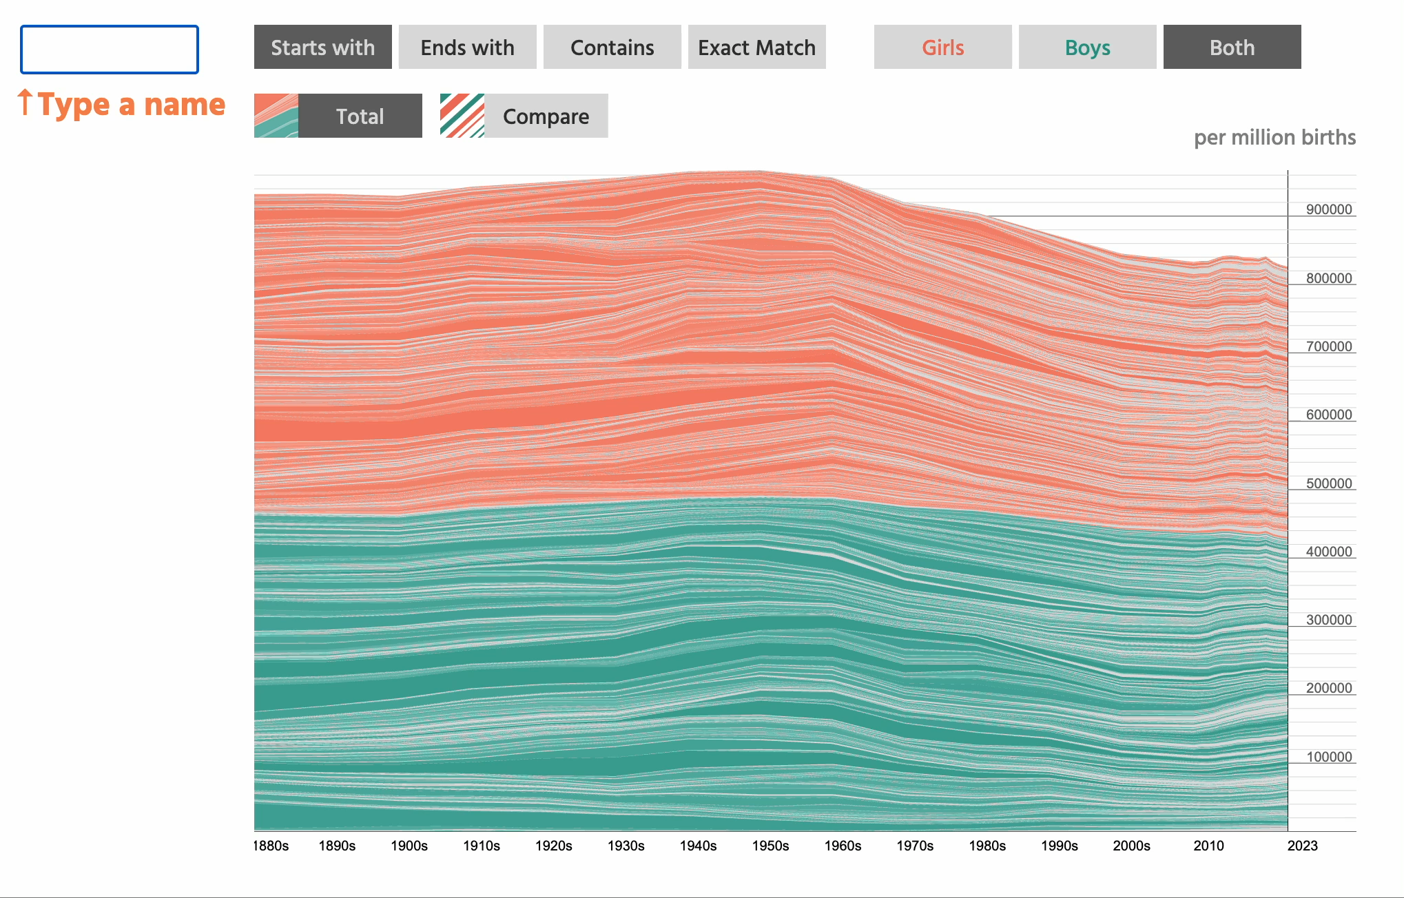
Show me something conditionally
6. Filter

Slide 26
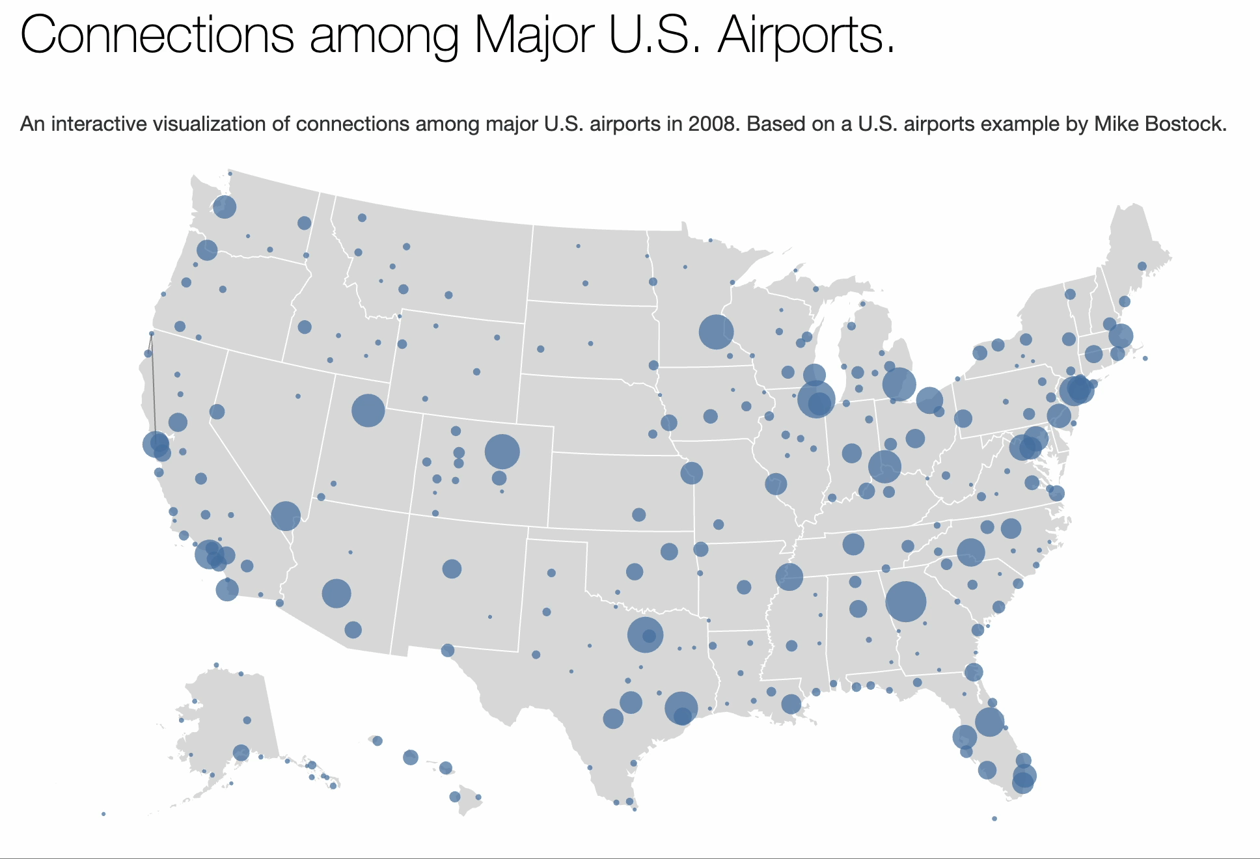
7. Connect
Show me related items: build-out

Slide 27
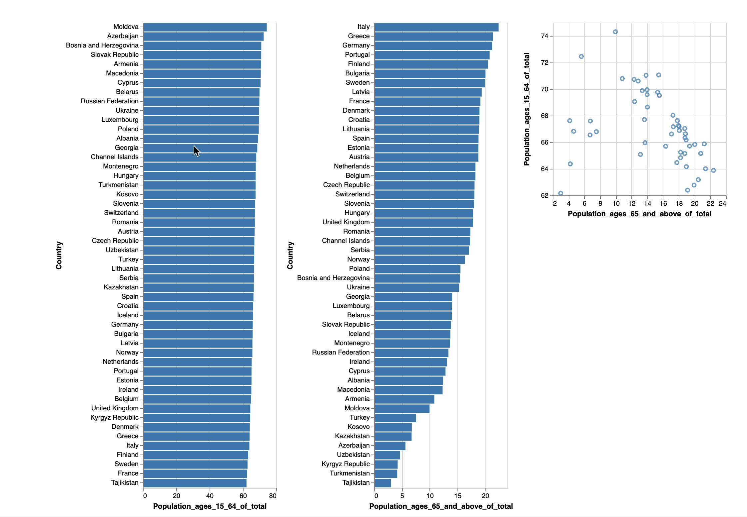
Show me related items: coordinated multiple views (CMV)
7. Connect

Slide 28
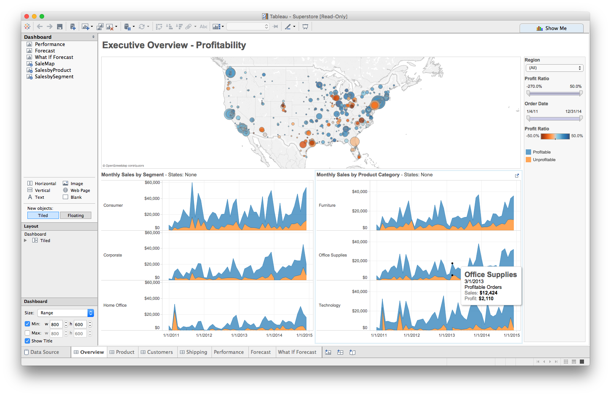
Multiple views
Different
representations
Different
data
Systems that use two or more distinct views
to support the exploration of a single concept or domain

Slide 29
Suggested questions to ask when designing
What is the goal of the analysis?
Decision-making
Better understand a domain or a problem
Identify the trends of a phenomenon
Forecast the future
…etc.
What kinds of operations do we need to enable?
How can the visualization support those operations?

Slide 30
Tableau CMV walkthrough
Demo: coordinated multiple views

